Slide 1


Online Retailer Week 2 Customer Segmentation
Data Science Capstone
Spring 2022 SECS 7259-01 22124
Vidya Rayanoothala

Slide 2
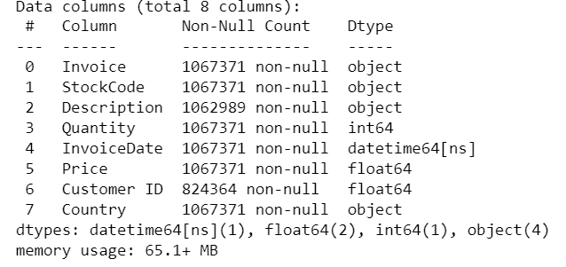
Online Retailer: Data Cleaning
Step 1: Combined 2 worksheets:
Year 2009-10 and 2010-11
Total 1067371 entries
Step 2: Removed entries without Customer ID
Reduced to 824364 entries
Step 3: Outliers: Negative Quantity and Price
Order Cancels have Negative Quantity. Also ‘C’ on Invoice number
Negative Price marked for bad debt adjustments (5 entries)
2 Bad debt adjustments (=22k amount) same date 12/8/11
Step 4: Exploratory Data Analysis
Amount spent by each Customer (ID)
Frequency of purchase
Value of each purchase
Country of purchase volume
Amount spent per country
Seasonality - Month of purchase

Slide 3
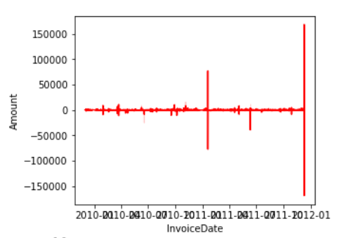
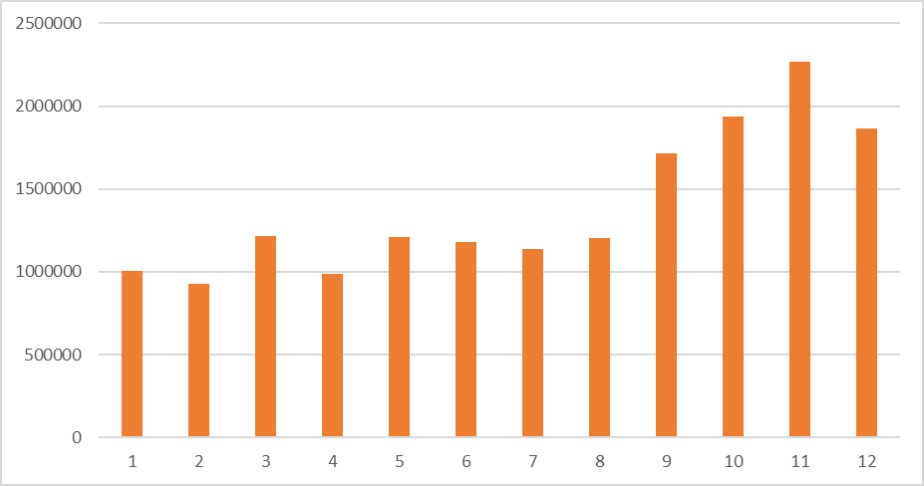
Online Retailer: Prelim learning
Revenue Generated in 2 years
5942 customers spent on average 2801.80 currency
Each customers had purchased on average approx. 7.5 times in 2 years, at least once and at most 508 times
On average, 293.97 spent by a customer on a purchase
75% of customer purchases within 357.41
Most Customers and most revenue generated from United Kingdom
Ireland, Netherlands, Germany, France, and Australia - top Revenue generating countries/ markets
Seasonality in revenue generated
Peak months: Q4 – Oct to Dec
Month over Month: Revenue Generated

Slide 4
Online Retailer: Next Steps
Analyze if any pattern in Cancel orders by Country, purchase Date/ month, Recent
Begin with RFM Analysis
Compliment findings with predictive analysis using K-Means Clustering Algorithms

Slide 5
Online Retailer Week 3 Customer Segmentation
Data Science Capstone
Spring 2022 SECS 7259-01 22124
Vidya Rayanoothala

Slide 6
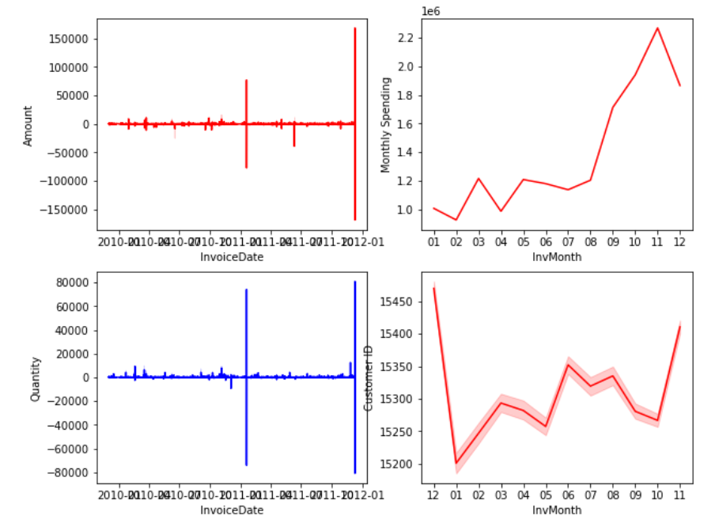
Online Retailer: Exploratory Data Analysis (contd.)
Further review of Cancel Orders:
Mainly coincided with peak order days
About a third of customers cancelled orders
Equates to just 8% of revenue
Top 3 Most cancels by Countries that order revenue with in Top 5:
United Kingdom
EIRE
France
About 49% of products have had cancelled orders

Slide 7
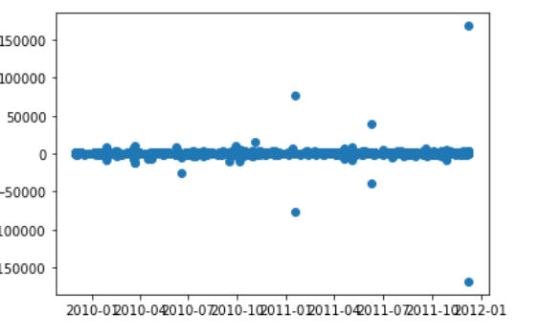
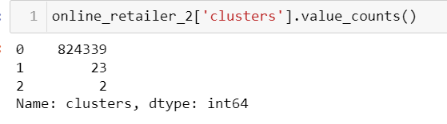
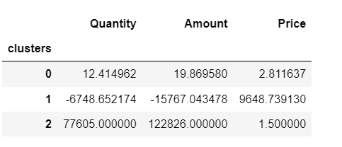
Online Retailer: Baseline vs. V1 model
Scatter plot of Revenue Generated
Scatter plot of revenue to time distribution indicated 3 clusters
Cluster 0: Orders with moderate revenue generation
Cluster 1: Orders that were cancelled and resulted in loss of revenue
Cluster 2: Orders with high revenue generation
K Means with 3 clusters shows similar composition as scatter plot clusters
Clusters Composition: v1

Slide 8
Online Retailer: Next Steps
Further work on K-Means Clustering to find Optimum K with Elbow method
Find the difference compared to hierarchical clustering
Reassess the clusters without cancelled orders

